Slide 1
Health Danger Alert System

Slide 2

Table of Contents:
Introduction
Problem Statement
Problem Solution
Conclusion

Slide 3

Introduction
The Health Danger Alert System is an UI based artificial neural network model designed to alert the hospital staff when the condition of the patient is serious.
There have been many cases in the past where patients lost their lives as the hospital staff were unaware of the serious condition of the patient.
So, in order to prevent this situation, we created Health Danger Alert System.

Slide 4
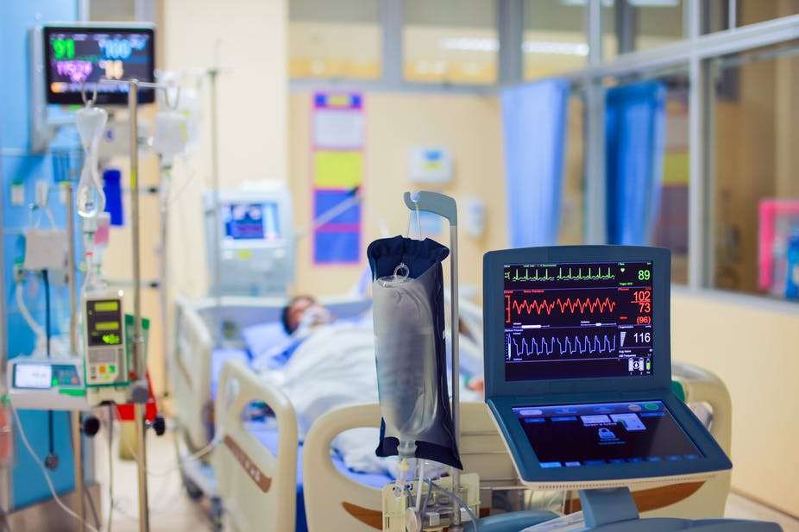
Problem Statement
A patient who is admitted in the hospital might get into serious condition when none of the hospital staff is around. In such cases, the hospital staff must be notified about the serious condition of the patient.

Slide 5
Problem Solution
To analyse the serious condition of the patient, we considered few parameters like age, heartbeat, blood pressure (systolic, diastolic) and sugar level.
The Health Danger Alert System will alert the hospital staff when at least one of the above mentioned parameters will go beyond the threshold value.
With the help of this system ,we can save the lives of the patients.

Slide 6
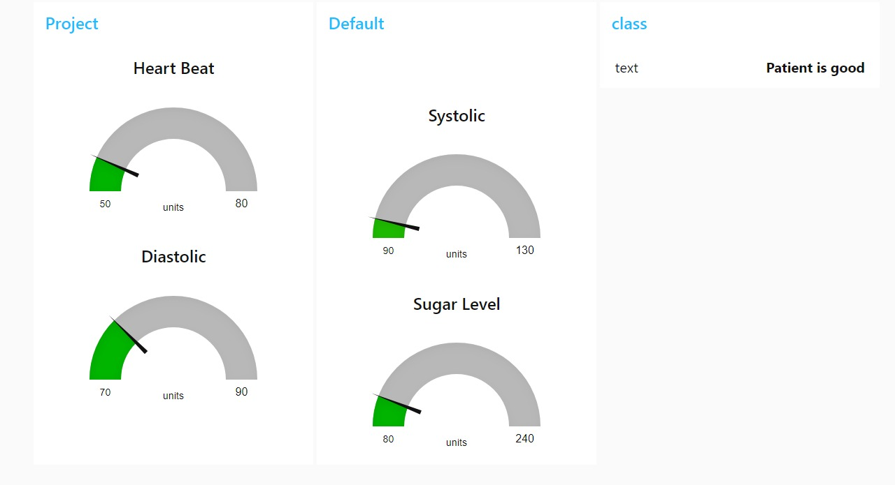
Good condition

Slide 7
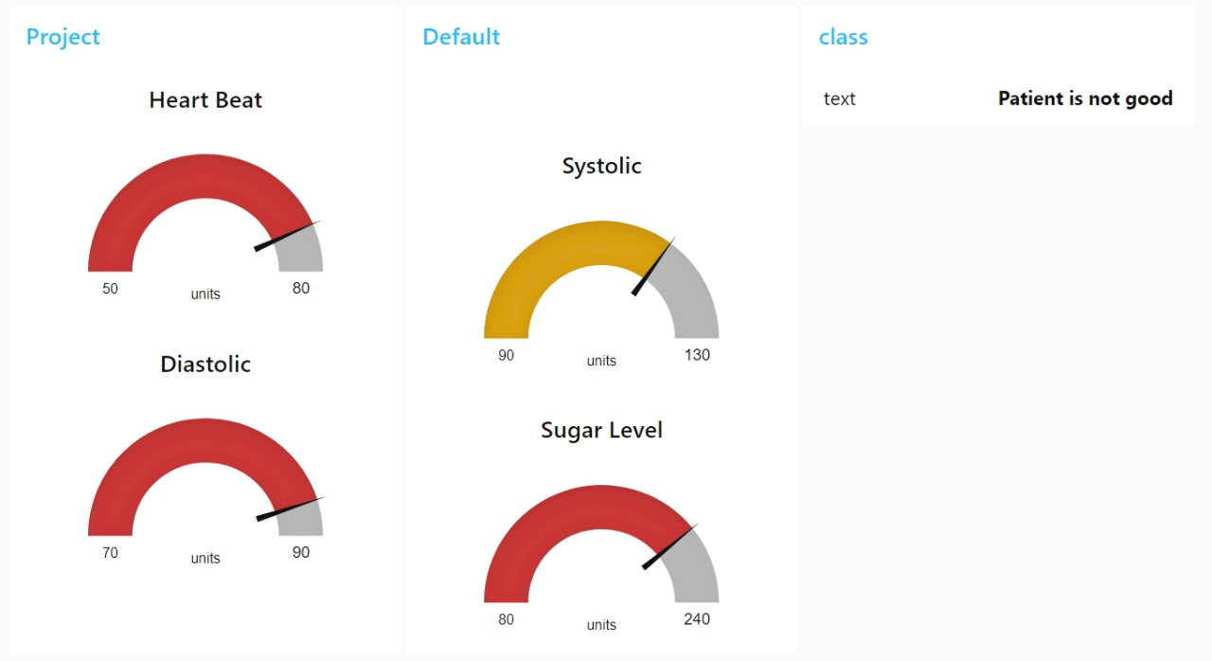
Bad Condition

Slide 8

Conclusion
So, the Health Danger Alert System can be integrated with the IOT devices and used in the hospitals to alert the hospital staff about the serious condition of the patient.
The Health Danger Alert System is to be made mandatory in every hospital in order to save the patients in ICU’s.

